Slide 1
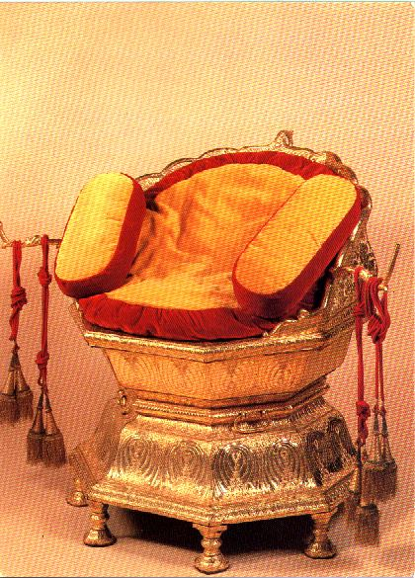
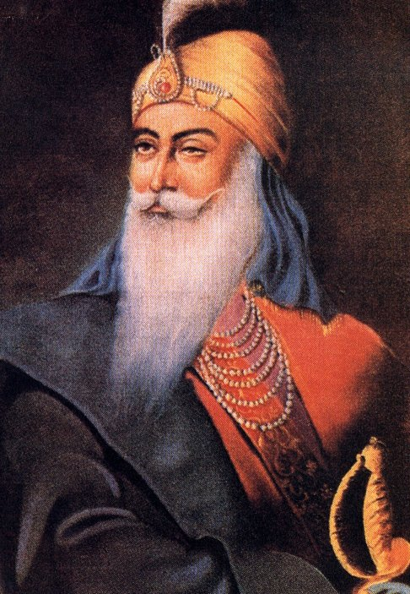
. No Crown, No King
No Turban, No Singh
REAL LIFE EPISODES

Slide 2
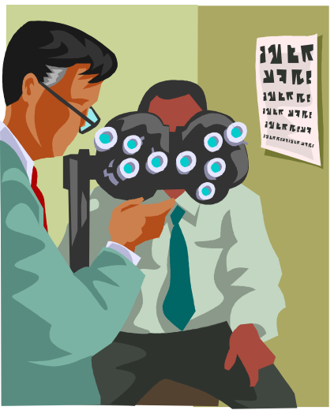
A young couple at Springfield, Maryland (Washington D.C.) USA.
I was waiting for my turn in the clinic of our family physician.
A European lady entered the clinic.
Without observing normal courtesy or any formality, she went straight to the doctor talking to a patient, and asked him, "Are you doctor Singh?"
The Physician and the patients, who were waiting & just looking towards her, were all surprised.
However, the doctor, instead of telling her to sit & wait, said, "Yes".”

Slide 3
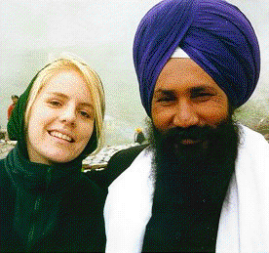
With an abnormal look at her face, she started pouring words out of her mouth in the form of a fast flowing stream, "I was in Delhi.
I know Singhs, they are good people.
I read Singh on your name-plate and came in to see you, but you are without a turban.
How come you have written the word Singh on your name-plate?
I tell you to either wear your turban or remove the word Singh from your name.“
As soon as she finished, she turned about and went out of the door.

Slide 4
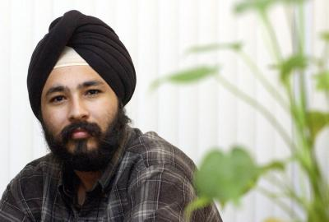
She had suddenly dropped in and in the same way she left the clinic quickly.
No one spoke any word; all of us were mute observers of this episode which took place in a flash of time.
With pleasure visible on his face, my host continued, She was a brave lady who bluntly told the doctor to wear a turban.
I always thought like that but did not know how to say that to him.
Whenever I visited him, I always wished he wore his turban, to bring good name to the Sikh community

Slide 5
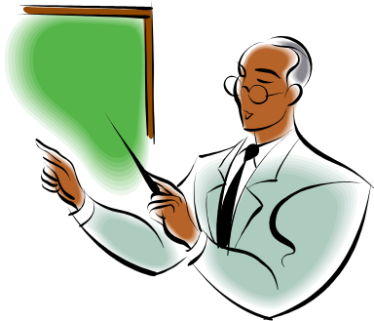
SECOND EPISODE
When I was teaching at the Punjab Agricultural University, Ludhiana, the wife of a friend of mine, during her courtesy visit to our house, narrated a very embarrassing episode.
When they returned to the University from a trip to their village.
When they reached the railway station, her husband went straight to the ticket window to purchase their tickets while she watched their luggage.

Slide 6
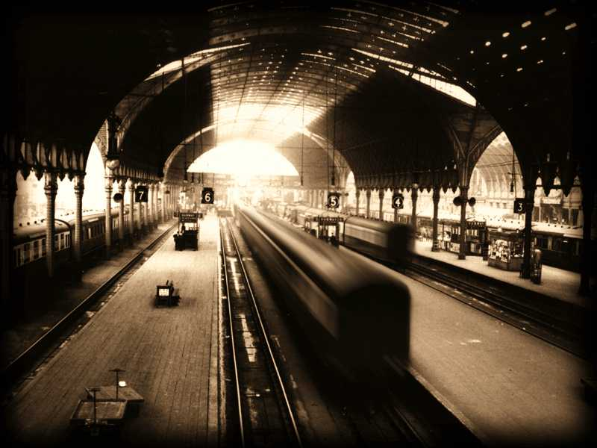
As the passengers in the queue seemed common people. Her husband, being a University professor, felt he could jump the queue.
So he walked straight to the ticket window.
A sardar jee standing in the queue yelled from behind, “Babu jee! Come back and join the queue.
We also want to purchase our tickets.”

Slide 7
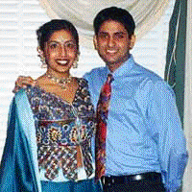
His wife did not relish the words babu jee for her professor husband with a Ph.D. from a foreign University.
She tried to correct him saying, He too is a sardar jee, and not babu jee.”
To her embarrassment, however, quick came the reply, He is keeping you with him but where did he lose his sardarhood, (turban, his identity)?”
She had no reply.
Meanwhile with a little pause, the passenger continued, He will be believed to be a sardar jee only if he wears a turban.”

